Slide 1


Ayiti Analytics Bootcamp
Data Processing
Presentation
Due Friday, June 25th

Slide 2
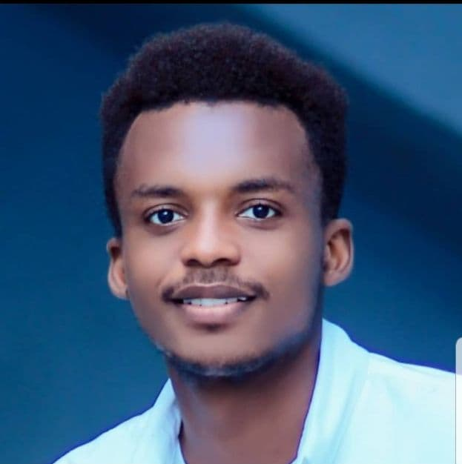
Presented by
Fred Junior NOEL, Economist-Statistician, Data Analyst.
https://www.linkedin.com/in/fred-junior-noel-ab58a2166

Slide 3
Problem
Ayiti Analytics Data wants to expand its training centers throughout all the communes of the country. As a data analyst, my role is to help them realize this dream.
Ayiti Analytics wants to expand its trainings through 3 communes immediately. This will allow them to find talented students in their fields for future projects, thus having a larger family of data specialists. Also, this training will allow students to have advanced training in data science for much more advanced analysis in their field and others.
Haiti Analytics is in its infancy. Expanding these trainings throughout the country is essential. 2 cohorts are already organized in Port-au-Prince. But the training must be decentralized. Many other opportunities can come from this action.

Slide 4
Methodology
We had to work with data from different data frames, coming from the registration files launched by Ayiti Analytics. Then we used Python to process and analyze the data. We used embedded libraries like NumPy, Pandas, Matplotlib, Seaborn, and more. Then, we interpreted the graphs in this Power Point presentation.

Slide 5
Results
The main questions we will address:
How many applications must be made to select 25% women for each on average
What are the most effective communication channels (Alumni, Facebook, WhatsApp, Friend ...) that will allow a student to be susceptible to selection
What is the average number of university students who should participate in this program
What will be the average number of applications per week that we could have
How many weeks should we extend the application process to select 60 students per commune?
If we were to do all the bootcamp online, who would be the best communes and how many applications would we need to select 30 student and what percentage of students would have a laptop, an internet connection, both at the same time
What are the most effective communication channels (Alumni, Facebook, WhatsApp, Friend ...) that will allow a women to be susceptible to selection

Slide 6
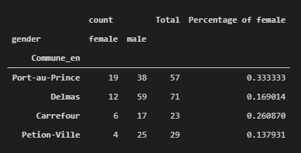
How many applications must be made to select 25% women for each on average
For the commune of Carrrefour, the percentage of women (applicants) is 26%. So it's easy to find a representative cohort sample with 25% women.
For Delmas, the number of female applicants is 17% out of a total of 71. To have a sample with 25% women, the total number of applicants must be at least ((71 * 25%)/17%)= 105.
Finally, for the commune of Petion-Ville, women represent 14% of the participants. Similarly, to have a sample with 25% women a total of at least ((29 * 25%)/14%)= 52 is required.

Slide 7
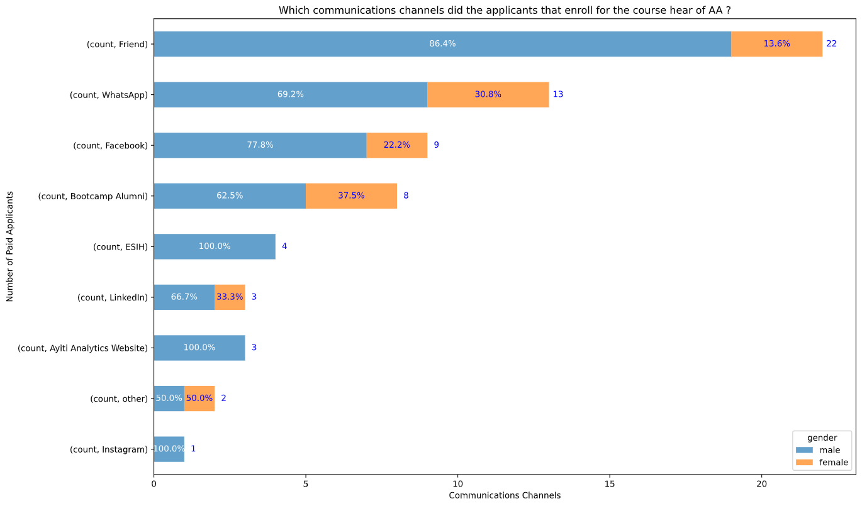
What are the most effective communication channels (Alumni, Facebook, WhatsApp, Friend ...) that will allow a student to be susceptible to selection
The most effective communication channels that will make a student responsive to the selection are Friend (with 22 students), WhatsApp (13) and Facebook (9)

Slide 8
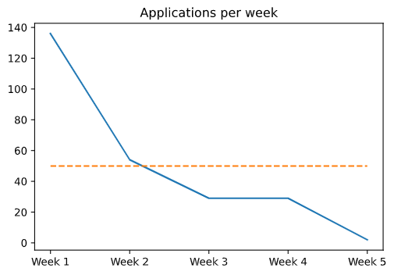
What will be the average number of applications per week that we could have
Here we have the evolution of the applications per week. We can see a decrease over the weeks.
The average number of applications per week is 50.

Slide 9
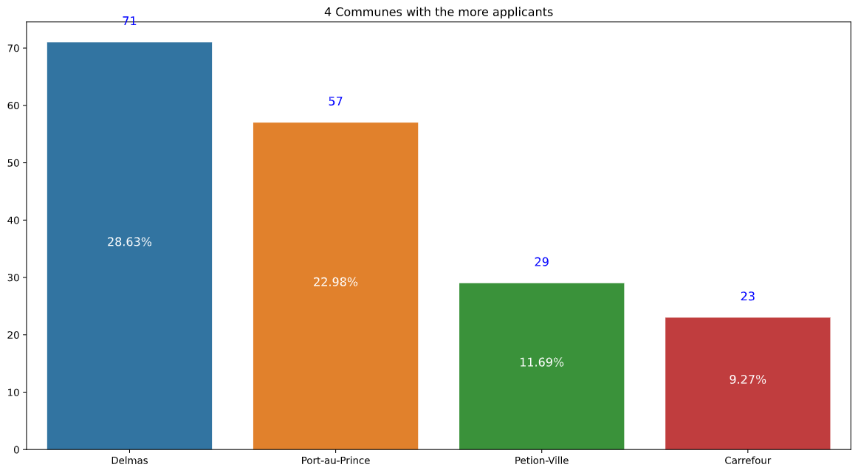
How many weeks should we extend the application process to select 60 students per commune?
Here we work with the average number of applications per week: 50.
For the commune of Delmas with 71 participants in 5 weeks, we do not need additional weeks.
Among the 50 applicants on average per week, 11.69% are from Petion-Ville (that is 5.8). In order to have 60 students, this commune must count on 11 weeks in total, that is to say 6 more weeks.
Similarly, for Carrefour with 9.27% of the 50 applicants on average per week (that is 4.6). This community needs 13 weeks in total, which is 8 weeks more.

Slide 10
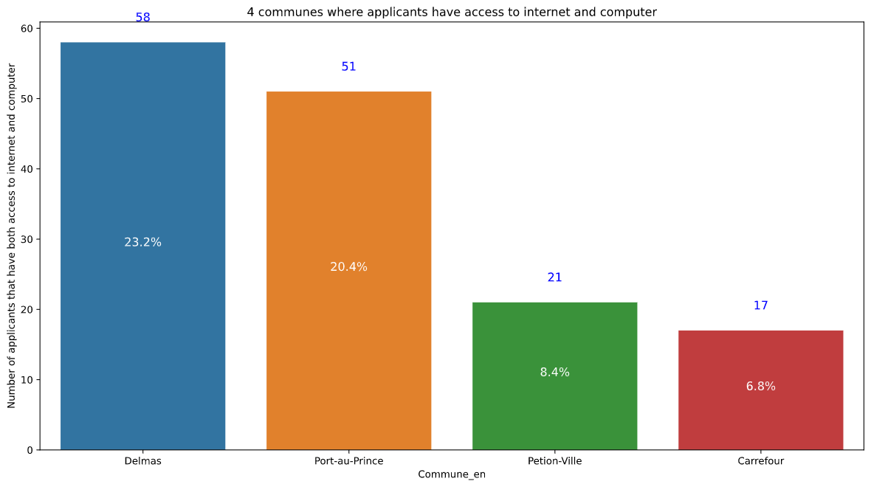
If we were to do all the bootcamp online, who would be the best communes and how many applications would we need to select 30 student and what percentage of students would have a laptop, an internet connection, both at the same time
Since we already have a Bootcamp in Port-au-Prince, the 3 communes that would be best to select 30 students are Delmas, where 58 students have both internet and computer access, Petion-Ville where 21 have access and Carrefour 17.

Slide 11
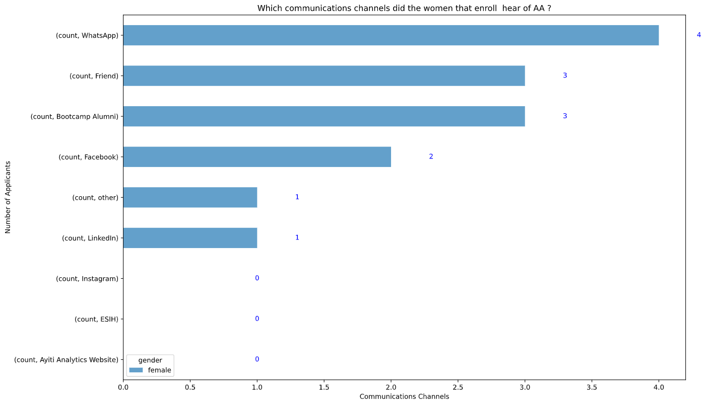
What are the most effective communication channels (Alumni, Facebook, WhatsApp, Friend ...) that will allow a women to be susceptible to selection
WhatsApp is the most effective communication channel that will allow a woman to be susceptible to selection.
Then we have Friend and Alumni.

Slide 12
Discussion & Proposed Solution
Based on these results, the three communes that are likely to receive the Ayiti Analytics training centers are Delmas, Petion-Ville and Carrefour (excluding Port-au-Prince where a 2nd cohort is underway)
Delmas is the commune where more women are interested in participating in a cohort.
A Friend is the most effective communication channel that will allow a student to be likely to be selected.
If Ayiti Analytics were to do the entire bootcamp online, Delmas would already be ready to select 30 students with both a laptop and an internet connection.

Slide 13
Delmas is by far the best commune to host an Ayiti Analytics training center.
For the other two (and even in general) it would be necessary to review some parameters, such as: Branding on social networks for more visibility, Awareness among women to understand the importance of data for decision-making, Support in terms of resources and work materials (computers, internet connection, ...)

Slide 14
POSITIVE
NEGATIVE
STRENGTH
WEAKNESS
A solid management team, very motivated
A multidisciplinary team using data
Social Media Marketing Strategy still weak
INTERNAL
OPPORTUNITY
THREAT
An innovative approach to teaching Data in Haiti for Decision-making (online, advanced software..)
Political instability
Lack of resources and working materials (internet connection, computers)
EXTERNAL

Slide 15
References & Appendices
bolossi509/Mini-Project-2: Data Processing Project (github.com)
https://drive.google.com/drive/folders/1zDRIaOh-oTZ2a942m732innBhpND--I2?usp=sharing

